Slide 1
Medication Review Market Analysis for Osteoporosis

Slide 2

Background. A Client Launched a New Medication
2017 – FDA approves the new medication to treat postmenopausal osteoporosis in the US
2021 – FDA approves the removal of some warnings of the new medication
Research Needs:
Which drugs are leading the osteoporosis market?
Who are the target demographics?
What are the market drivers?
How can the new medication disrupt the market?
2

Slide 3
Approach and Methodology
Which drugs are leading the market?
Data mining to identify the most popular drugs to treat osteoporosis.
Who are the target demographics?
Analyze data to identify the demographics of the users.
I
Data Analytics
II
How can the client disrupt the market?
Analyze the medication reviews to understand what marketing opportunities exists.
Language Model

Slide 4



About the Data
Dataset
12 Features
Data Preprocessing
WebMD Drug Reviews
Context:
The dataset provides user reviews on specific prescription drugs along with conditions, side effects, age, sex, and user rating reflecting overall patient satisfaction.
Source: https://www.kaggle.com/datasets/rohanharode07/webmd-drug-reviews-dataset.
Size: 362,806 x 12
Drug (categorical): name of drug
DrugID (numerical): drug id
Condition (categorical): name of condition
Review (text): patient review
Side (text): side effects associated with drug (if any)
EaseofUse (numerical): 5 star rating
Effectiveness (numerical): 5 star rating
Satisfaction (numerical): 5 star rating
Date (date): date of review entry
UsefulCount (numerical): number of users who found review useful
Age (numerical): age group range of user
Sex (categorical): gender of use
Restrict condition to osteoporosis
Remove duplicate reviews
Re-code the age to the desired buckets
4

Slide 5
Overview of Osteoporosis-related Illnesses
Conditions | Number of Reviews
Osteoporosis Post-Menopausal Osteoporosis Prevention | Female: 1116 Male: 71 Unspecified: 170 Number of Unique Drugs: 71 Rating Records from 2007 to 2020
5

Slide 6
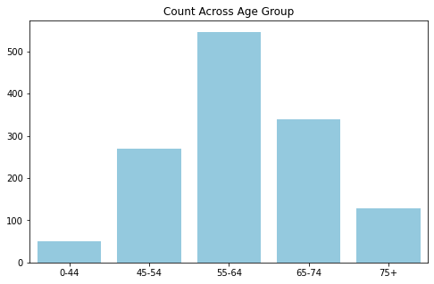
Target Demographics
Statistics:
82% of the patients are women.
Observation:
A large majority of the patients are from ages 45-74.
Conclusion:
Women in the ages 45-74 is the target demographic for Osteoporosis medications.
6

Slide 7
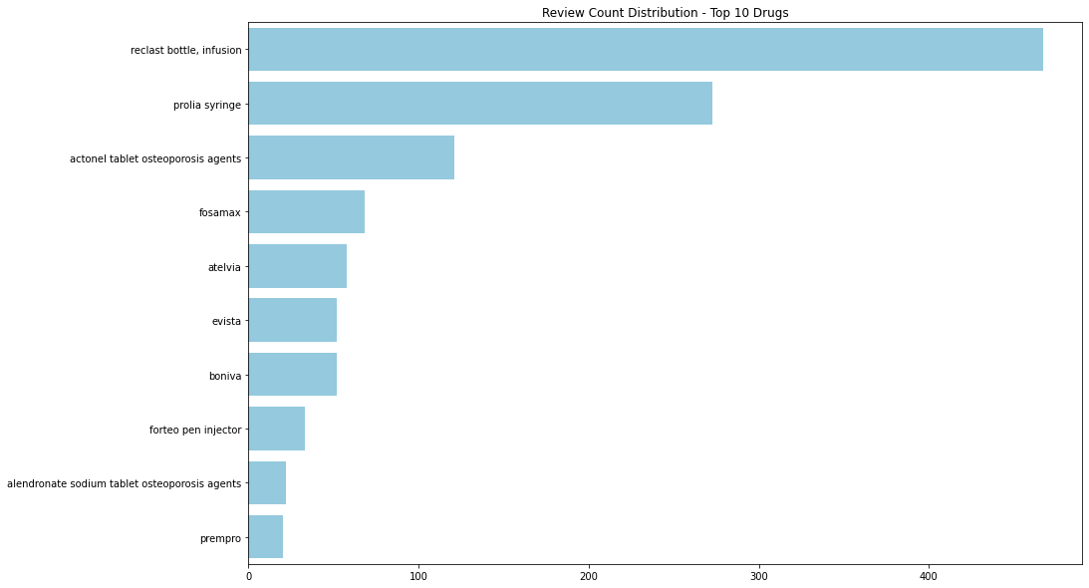
Top Medications Based on Number of Reviews
Assumption:
Amount prescribed is proportional to the amount reviewed.
Observation:
Reclast Bottle, Prolia, and anctonel tablet are the most reviewed drugs.
7

Slide 8
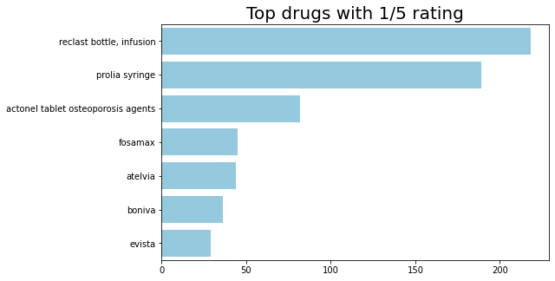
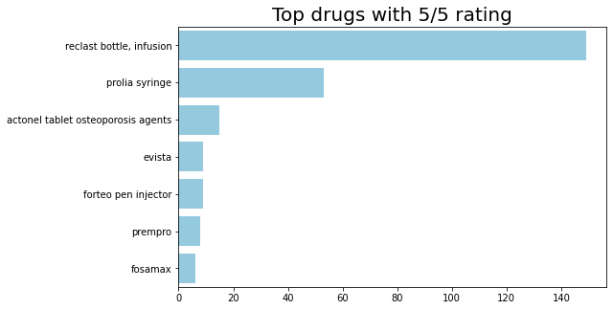
Best and Worst Drugs Based on Ratings
Observation:
Reclast Bottle, Prolia, and Actonel Tablet are top 3 for BOTH the worst and the best rated drugs.
8

Slide 9
Client Medication - Snapshot
Redacted Drug Name
Age | 55 – 74
Sex | Female
Effectiveness | 3 / 5
Ease of Use | 4.3 / 5
Satisfaction | 2 / 5
Known Side Effects | Dizziness, Fast Heart Beat, Fatigue, Abdominal Pain
Observation:
The client is targeting the right demographics but the average satisfaction score is low.
Need further analysis as to why it is not performing well and a strategy to increase satisfaction.
9

Slide 10
Approach and Methodology
Which drugs are leading the market?
Analyze current market data to identify the most prescribed drugs to treat osteoporosis.
Who are the target demographics?
Analyze current market data to identify the demographics of the users.
I
Data Analytics
II
How can the client disrupt the market?
Analyze the medication reviews to understand what opportunities exists in the market.
Language Model

Slide 11

Introduction of Language Model
Formal Language Models
Grammar: a formal specification of the permissible structures for the language
Parsing: the method of analyzing the sentence to see if its structure is compliant with the grammar
Stochastic Language Models
The probabilistic relationship among a sequence of words can be directly derived and modeled from the corpora with stochastic language models.
11

Slide 12
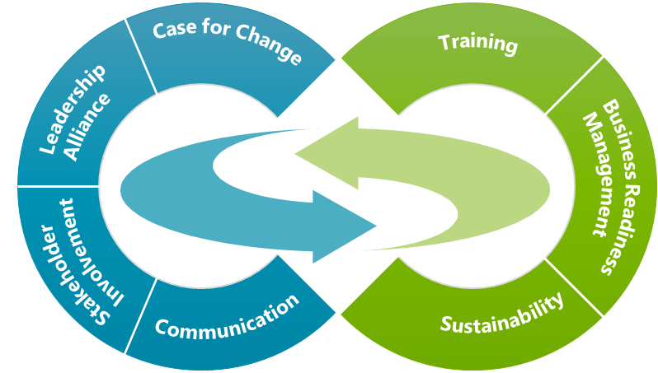

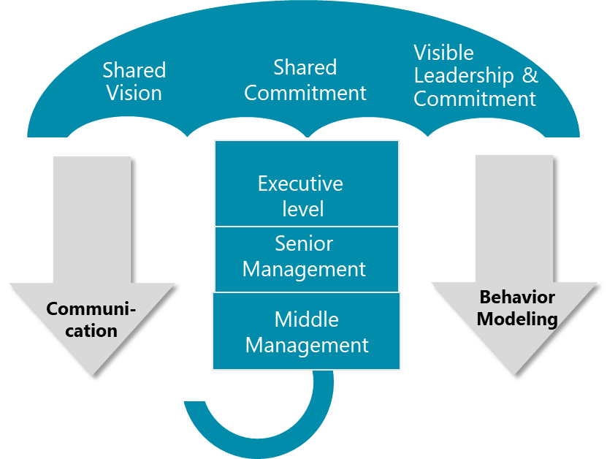








Application of Language Model
Language model is a major part of NLP and finds its use in a lot of places:
Sentiment Analysis
Entity Recognition
Question Answering
Speech Recognization
Machine Translation
Summarization
.
12

Slide 13








Use Cases of NLP in Healthcare
Clinical
Documentation
Speech
Recognition
Data Mining
Research
Computational
Phenotyping
AI Chatbot
and Virtual Scribe
Clinical Trial
Matching
Review Management &
Sentiment Analysis
Clinical Decision Support
13

Slide 14

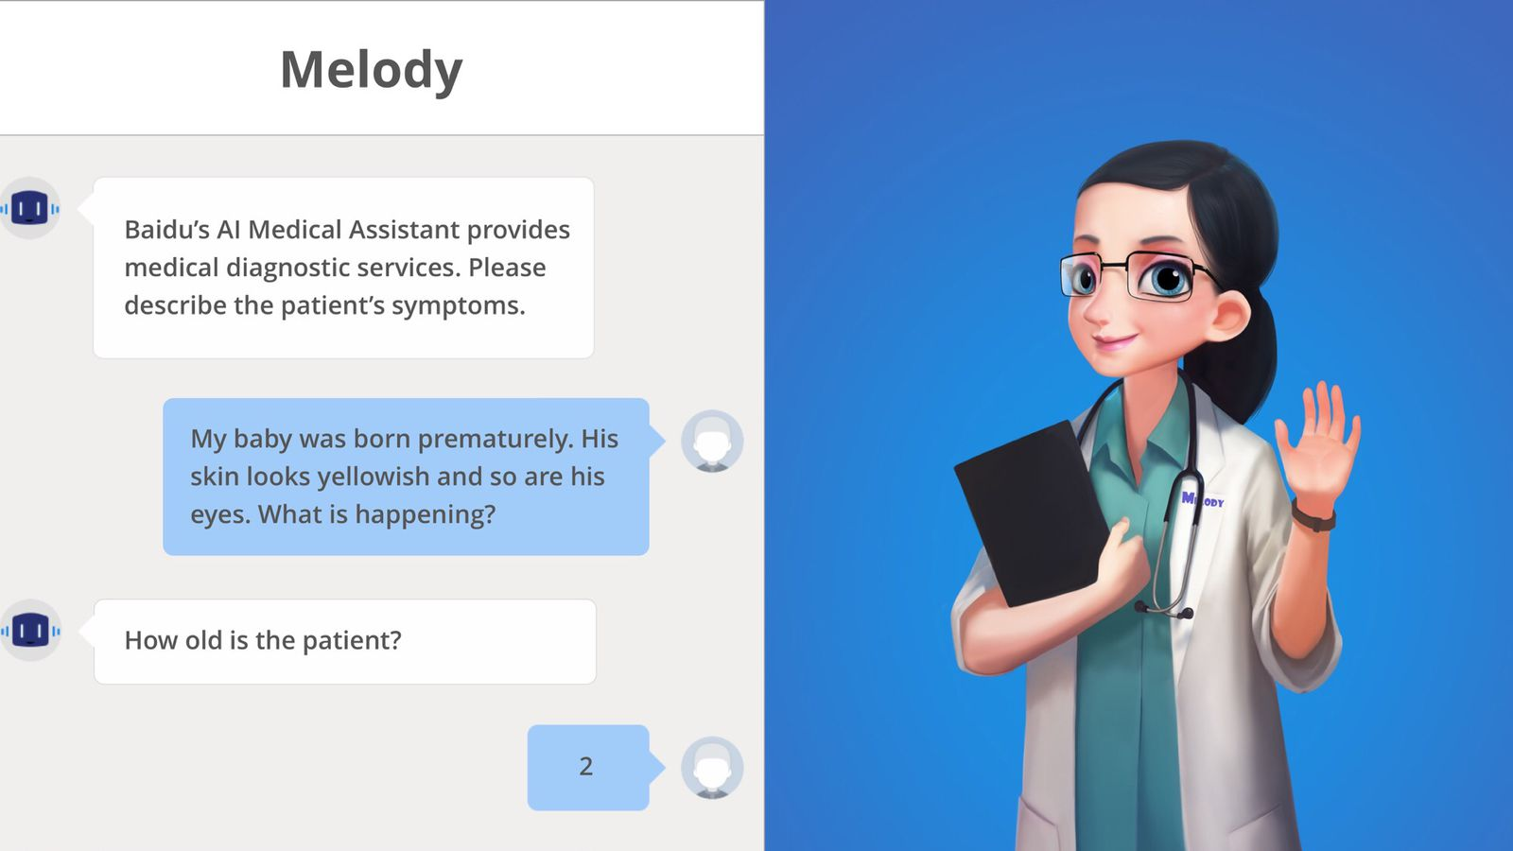
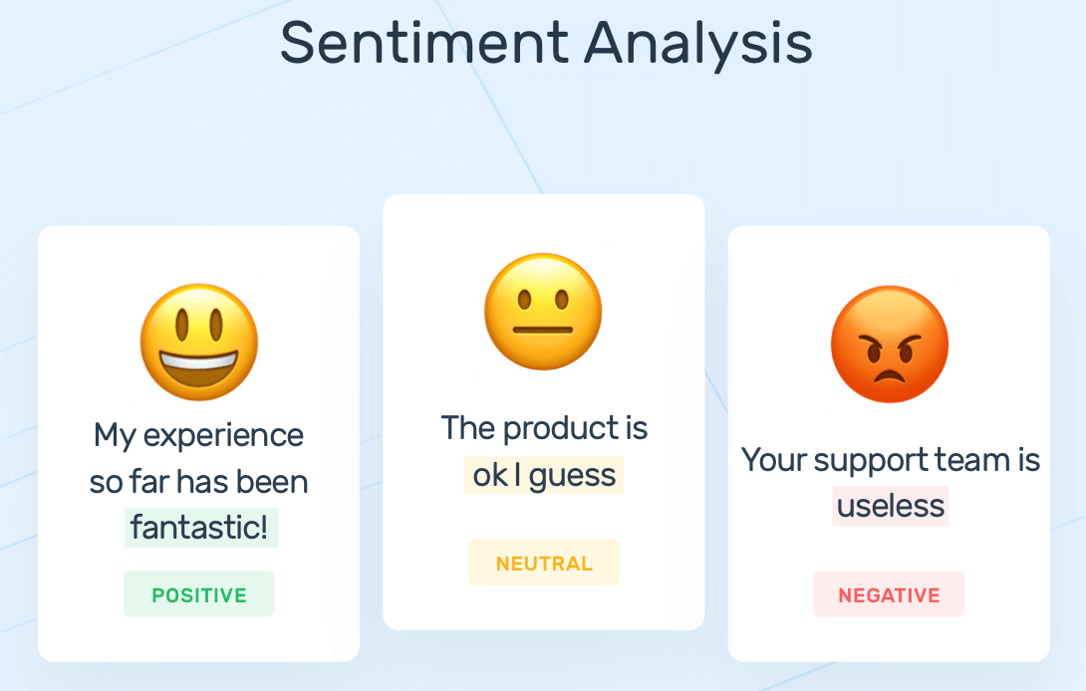
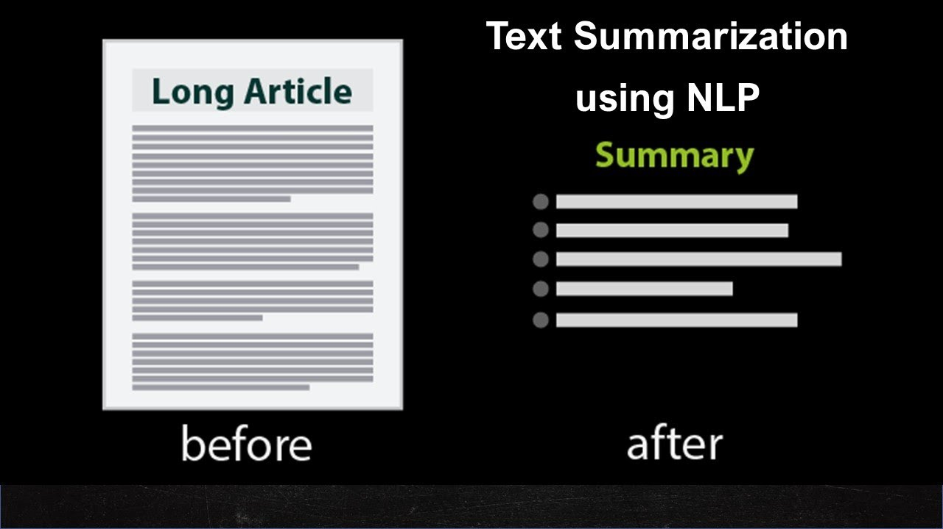
In Our Case: Huggingface BART Model
A B C D E
Bidirectional
Encoder
Autoregressive
Decoder
A __ B __ E
<s> A B C D
Model Architecture
BART uses a standard Transformer-based neural machine translation architecture for reconstructing the original text
BART is particularly effective when fine-tuned for text generation but also works well for comprehension tasks(e.g., conversational chatbots, language translation, sentiment analysis, or a tool to summarize texts).
*Note: https://huggingface.co/docs/transformers/model_doc/bart.
14

Slide 15





In Our Case: BART-Large + Drug Reviews from WebMD
Categorize drug reviews
Which categories do these reviews fall into? Side effect or effectiveness？
Identify the common side effects
Which side effects are the market drivers?
Connect to patient demographics
What are the demographics for each side effect?
BART Model
+
Drug Reviews
Measure sentiments toward
specific medications
What attitudes do people have toward specific medications? Negative or positive?
15

Slide 16
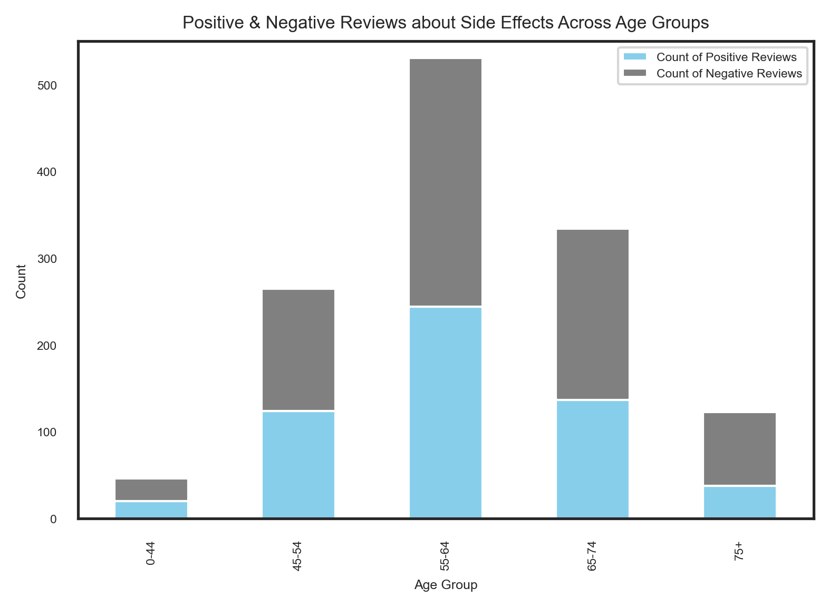
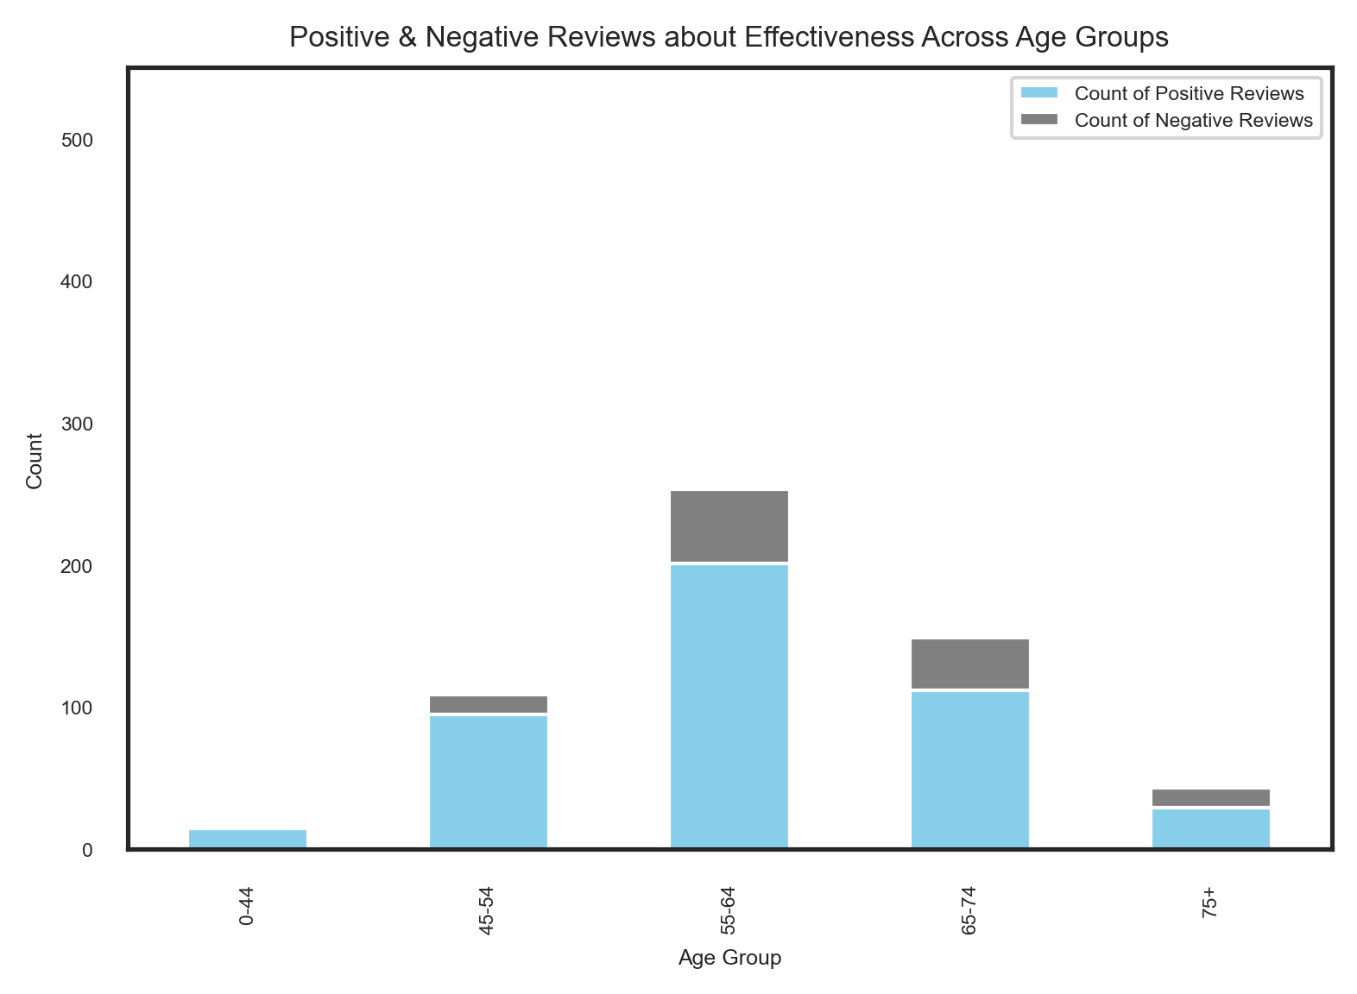
Reviews about Side Effects/Effectiveness
Observation:
Observation:
Almost all reviews were related to side effects.
Majority of the reviews related to effectiveness were positive.
16

Slide 17
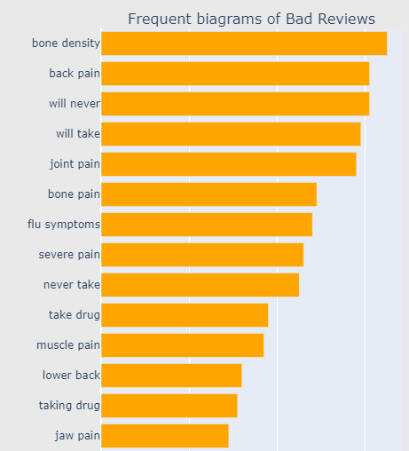
Identifying Specific Side Effects
Side Effect Labels for Zero-Shot Classification
Limb pain
Gastrointestinal
Dental
Cardiac
Dermatological
Respiratory
Weight gain and loss
Headache
Menstrual
Fatigue
Body Temperature
17
Notes:
Out of the box model tuned on internet
Use it to classify
Tuning afterwards for better accuracy

Slide 18
Zero Shot Classification - Example
Review1:
I have had no side effects other than a mild headache the day after.
I am hopeful and will definitely continue with the yearly injection.
Review2:
After taking this medication the bones in my chest ached and I had lower back and hip pains,
and I was very tired and weak. The next morning, I had intermittent nausea and dry heaves.
Drinking lots of water helped with the nausea. I regained most of my strength two days later.
18

Slide 19
Zero Shot Classification - Example
Review1:
I have had no side effects other than a mild headache the day after.
I am hopeful and will definitely continue with the yearly injection.
Review2:
After taking this medication the bones in my chest ached and I had lower back and hip pains,
and I was very tired and weak. The next morning, I had intermittent nausea and dry heaves.
Drinking lots of water helped with the nausea. I regained most of my strength two days later.
19

Slide 20
Zero Shot Classification - Example
Review1:
I have had no side effects other than a mild headache the day after.
I am hopeful and will definitely continue with the yearly injection.
Review2:
After taking this medication the bones in my chest ached and I had lower back and hip pains,
and I was very tired and weak. The next morning, I had intermittent nausea and dry heaves.
Drinking lots of water helped with the nausea. I regained most of my strength two days later.
20

Slide 21
Zero Shot Classification - Example
Review1:
I have had no side effects other than a mild headache the day after.
I am hopeful and will definitely continue with the yearly injection.
Review2:
After taking this medication the bones in my chest ached and I had lower back and hip pains,
and I was very tired and weak. The next morning, I had intermittent nausea and dry heaves.
Drinking lots of water helped with the nausea. I regained most of my strength two days later.
21

Slide 22
Zero Shot Classification - Example
Review1:
I have had no side effects other than a mild headache the day after.
I am hopeful and will definitely continue with the yearly injection.
Review2:
After taking this medication the bones in my chest ached and I had lower back and hip pains,
and I was very tired and weak. The next morning, I had intermittent nausea and dry heaves.
Drinking lots of water helped with the nausea. I regained most of my strength two days later.
22

Slide 23
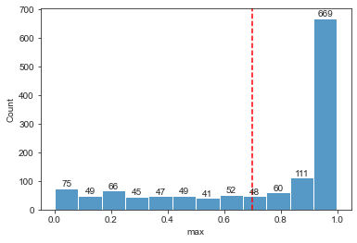
Zero Shot Classification - Example
Review1:
I have had no side effects other than a mild headache the day after.
I am hopeful and will definitely continue with the yearly injection.
Review2:
After taking this medication the bones in my chest ached and I had lower back and hip pains,
and I was very tired and weak. The next morning, I had intermittent nausea and dry heaves.
Drinking lots of water helped with the nausea. I regained most of my strength two days later.
Result:
Zero-Shot Classification resulted in 66% of the data being classified into the labels with higher than 0.7 probability level.
23

Slide 24
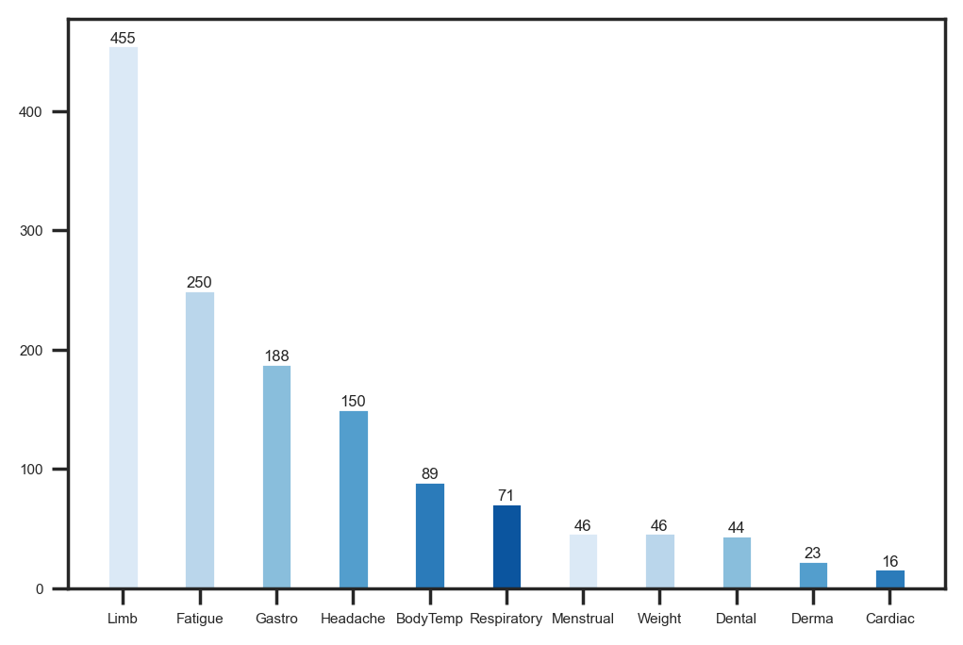
Most Common Side Effects
Observation:
Limb pain, Fatigue, Gastrointestinal and Headache were the most common side effects.

Slide 25
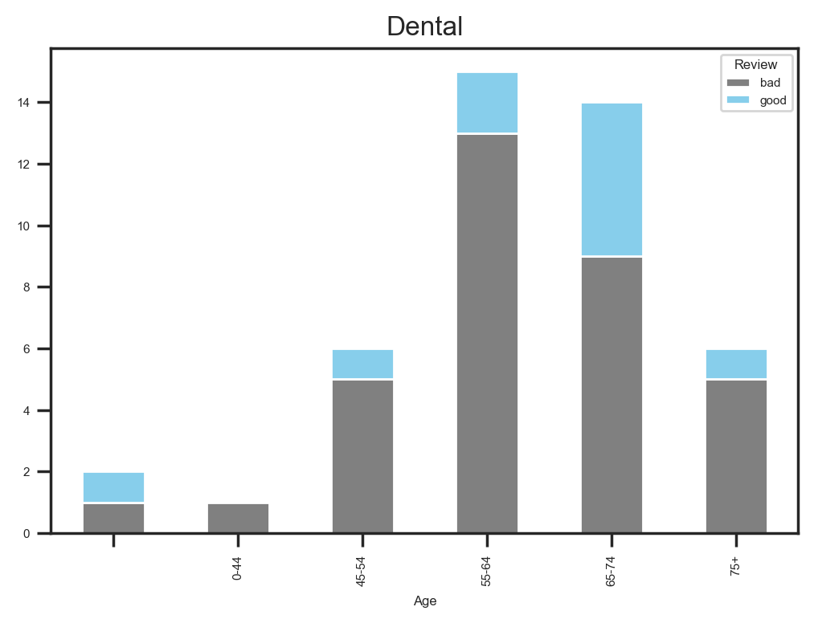
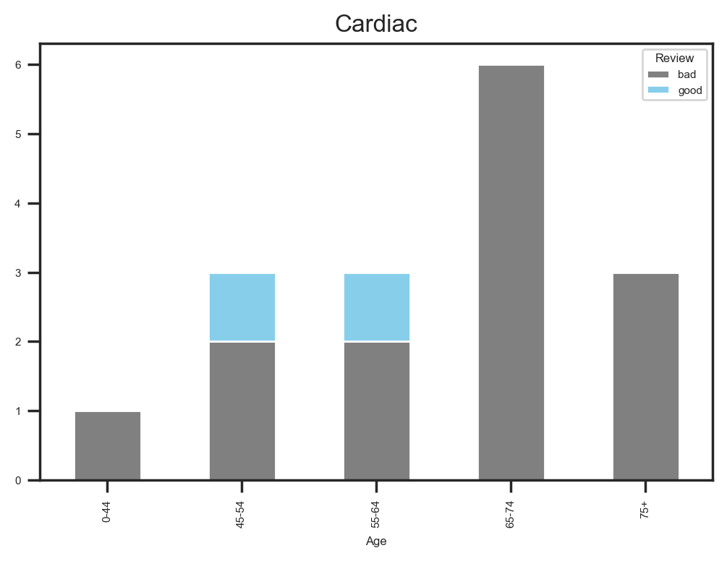
Who Suffers from the Side Effects?
Observation:
Older demographics suffered more from Dental and Cardiac related side effects
25
Notes:
45-54 who suffer less from cardiovascular side effects
Dizziness
Fast heart beat
Fatigue
Abdominal pain

Slide 26
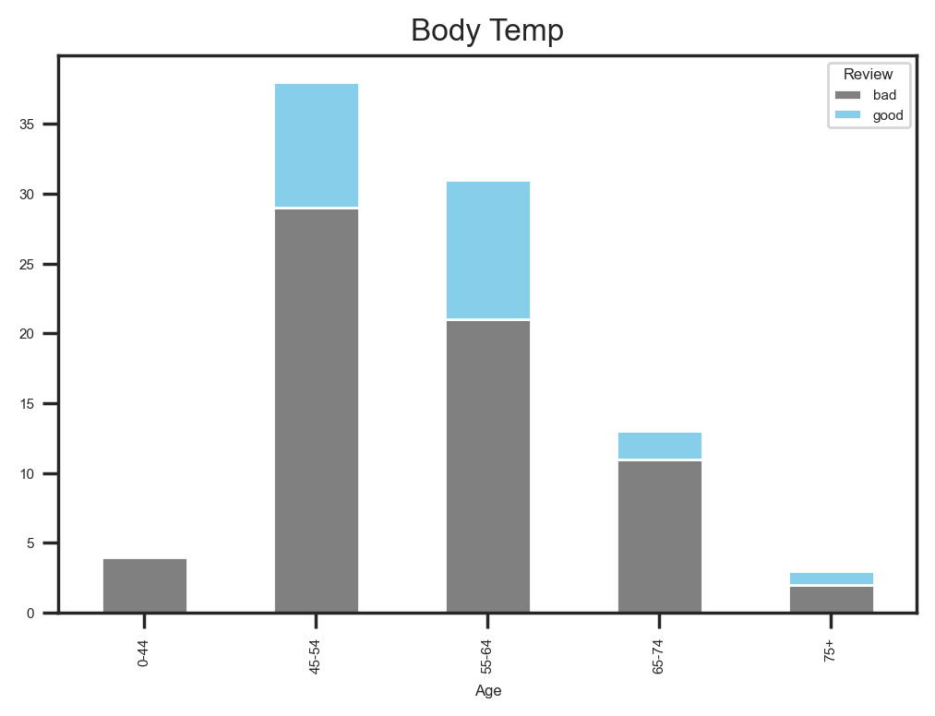
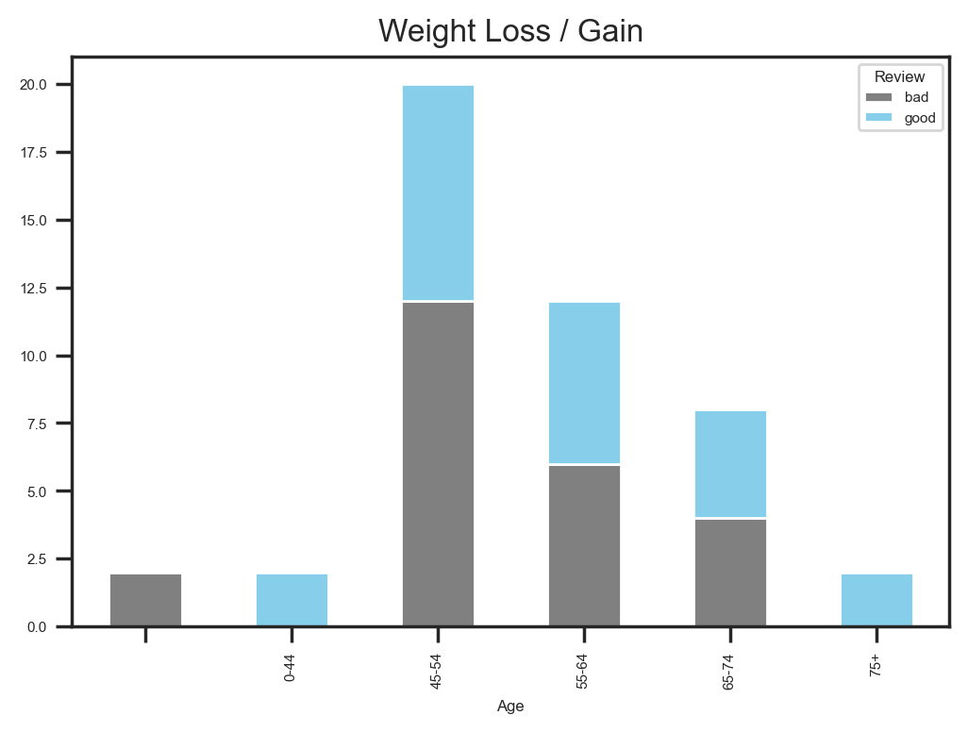
Who Suffers from the Side Effects?
Observation:
Younger demographics suffered more from Body Temperature change and Weight change side effects
26
Notes:
45-54 who suffer less from cardiovascular side effects
Dizziness
Fast heart beat
Fatigue
Abdominal pain

Slide 27
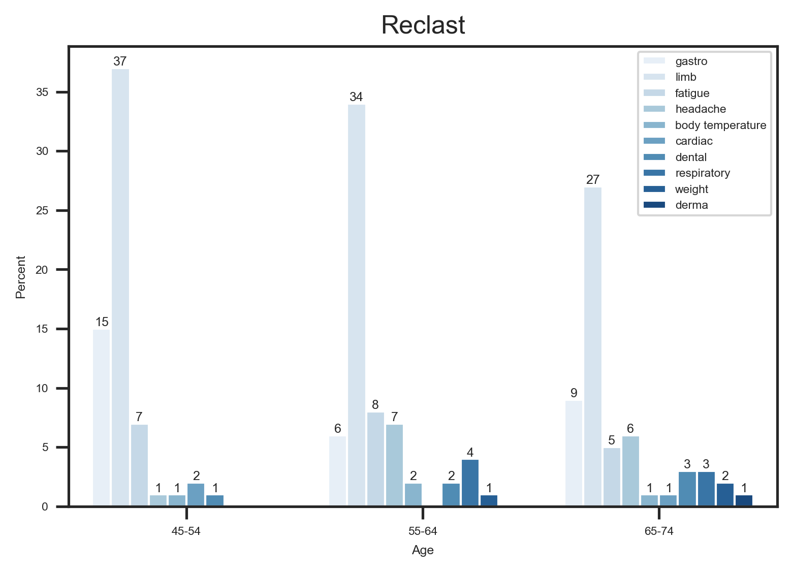
Opportunities Against Market Leaders - Reclast
Insight:
Reclast has a lot of gastrointestinal and limb pain related side effects which the client‘s medication does not.
27
Notes:
45-54 who suffer less from cardiovascular side effects
Dizziness
Fast heart beat
Fatigue
Abdominal pain

Slide 28
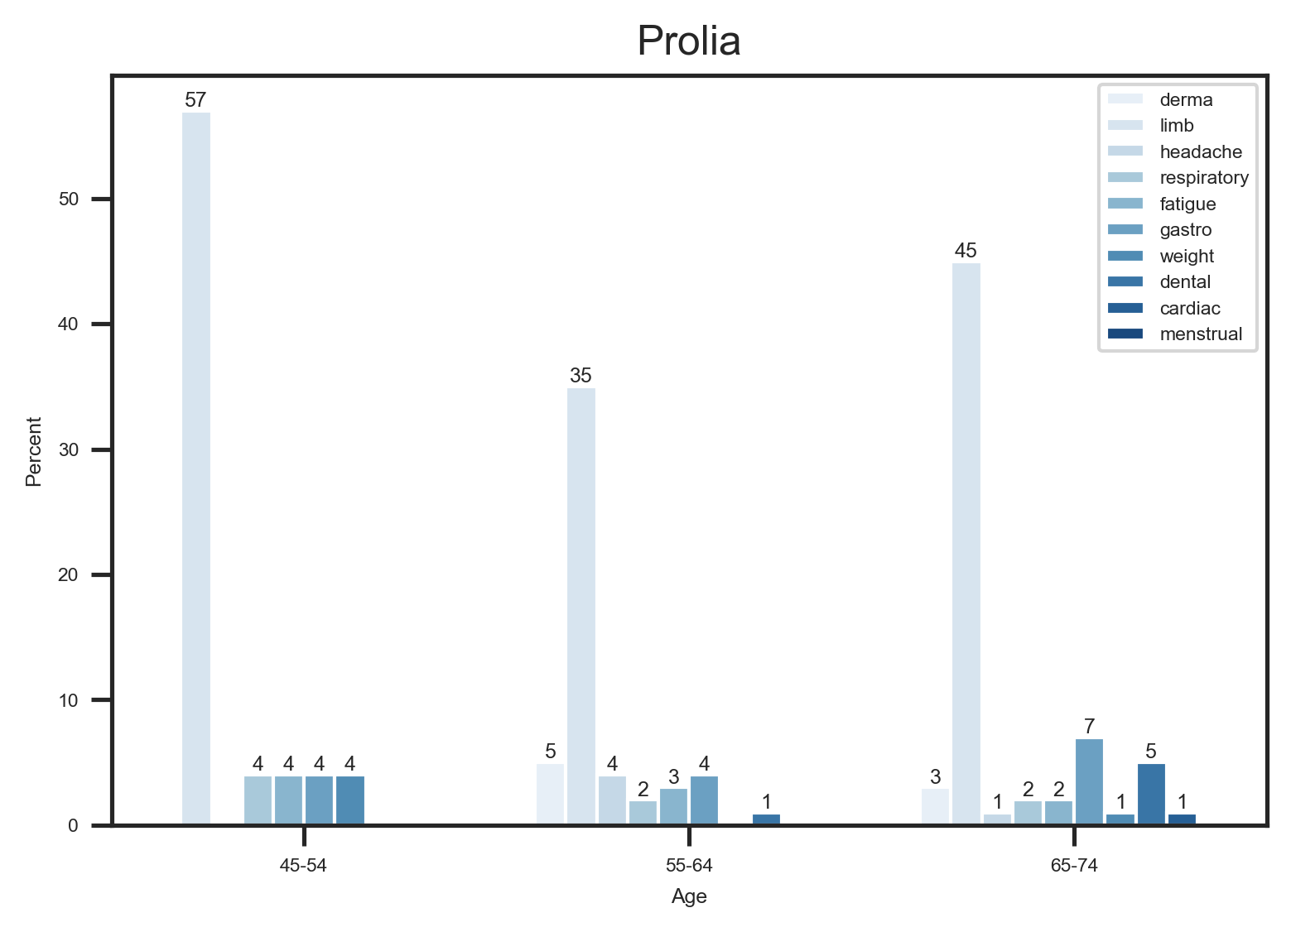
Opportunities Against Market Leaders - Prolia
Insight:
Prolia has a lot of dermatological and limb pain related side effects which the client‘s medication does not.
28
Notes:
45-54 who suffer less from cardiovascular side effects
Dizziness
Fast heart beat
Fatigue
Abdominal pain

Slide 29
Summary Insights
Which drugs are leading the market?
Reclast bottle, Prolia, and Actonel Tablet are the top 3 medications in the market that treat osteoporosis.
Who are the target demographics?
Women between the ages of 45-74
I
Data Analytics
How can the new medication disrupt the market?
Plan of Attack: Top medications have concerning dermatological, gastrointestinal, and limb pain related side effects.
Defensive Strategy: Warning against older patients for potential cardiovascular related side effects. Advise to take before bed due to lethargic side effects reactions.
II
Language Model

Slide 30

Way Forward
Fine Tuning to improve classification.
(currently only 66% of the data were classified with 0.7 probablitly confidence level)
Language models to further identify side effects.
Some reviews mentioned that they were not informed of such side effects.
Deeper analysis on effectiveness.
Marketing strategy around the new medication‘s effectiveness against other medications.
Notes:
Identify unknown side effects
Effectiveness, does the medication work better on certain
Second bullet point is the whole point of our analysis, we added “further”

Slide 31

Appendix

Slide 32
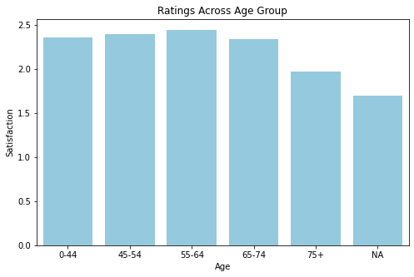
Frequency and Review Scores of Age Demographics.
Insights:
Frequency appears normally distributed over age, centered in the 55-64 age group while review scores are about uniformly distributed over age.

Slide 33
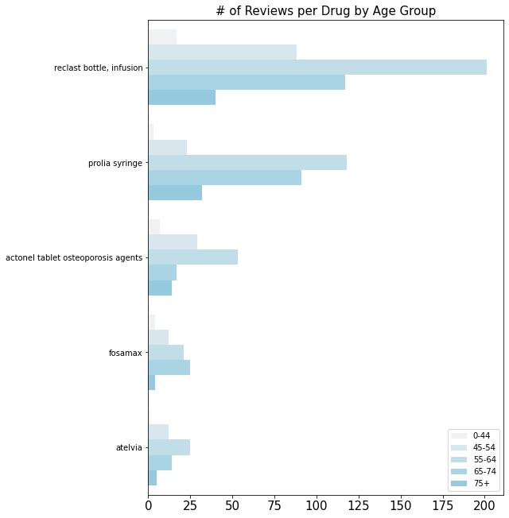
Frequency of Reviews for most Reviewed Medications.
Insights:
Frequency appears normally distributed over age, centered in the 55-64 age group while review scores are about uniformly distributed over age.

Slide 34
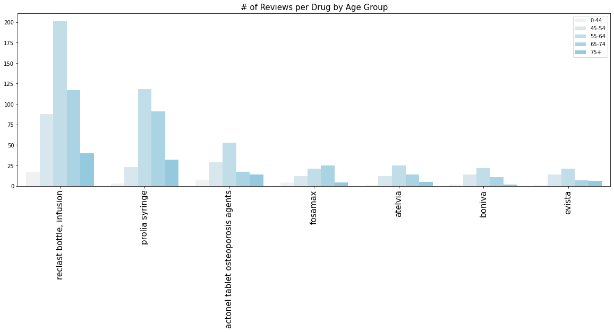
Frequency of Reviews by Age Group For Most Reviewed Medications
The age proportions remain constant across the most frequently reviewed drugs.
Notes:
One or two sentences, distinct color

Slide 35
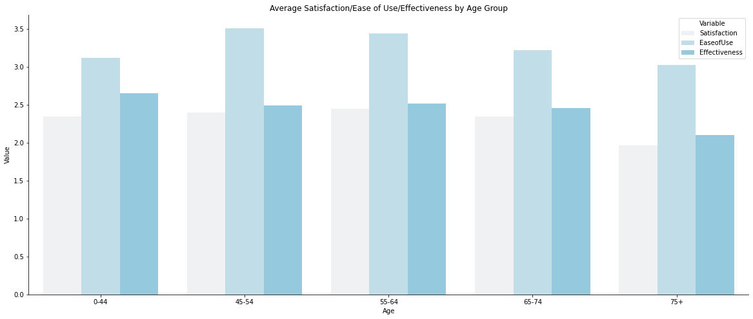
Average Ratings for Satisfaction, Ease of Use, and Effectiveness Across Age.
Insights:
There does not appear to be a major relationship between age and these three features.
Bullet 2

Slide 36
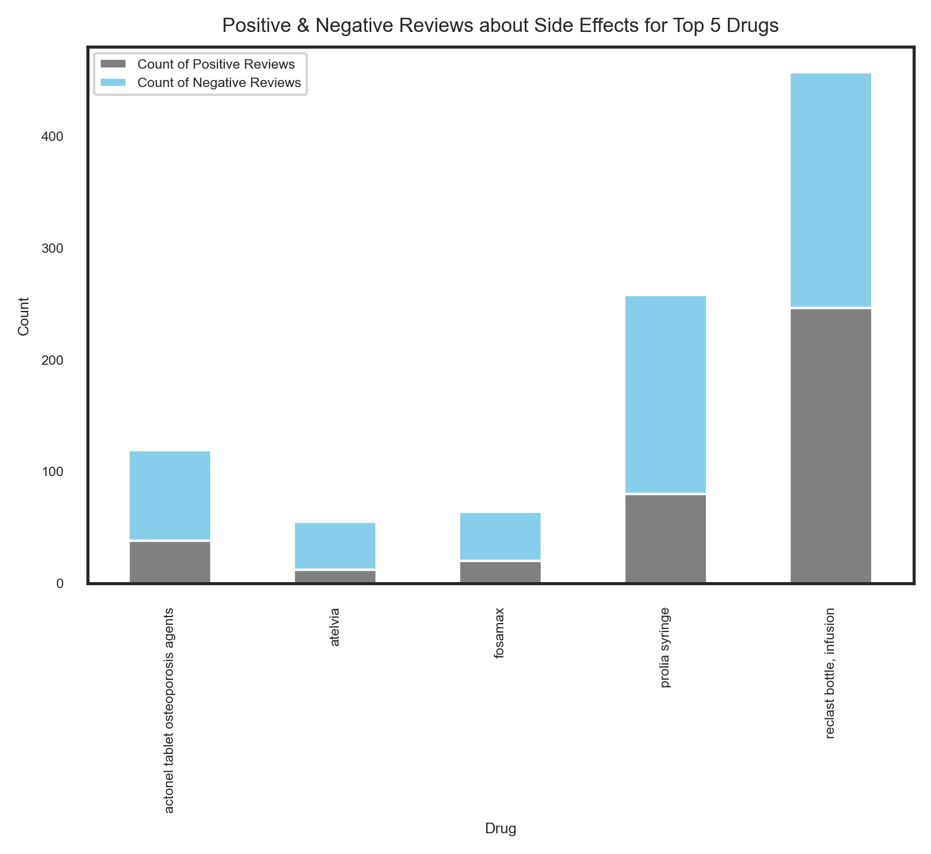
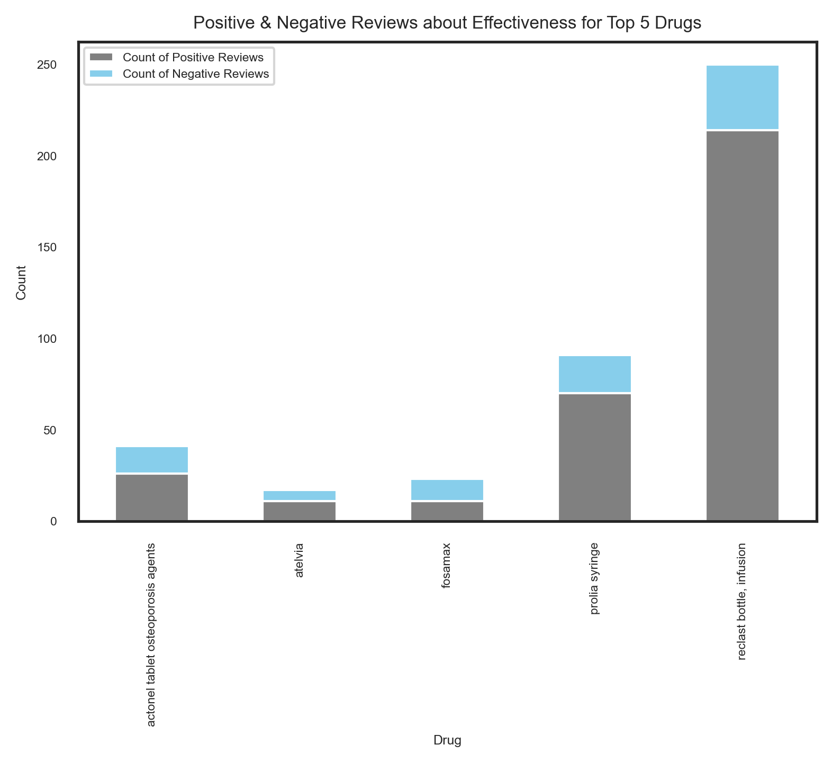
Positive & Negative Reviews about Effectiveness and Side Effects for Top5 Drugs
36
Notes:
Reclast bottle, infusion is the most effective medication, but also has serious side effects

Slide 37
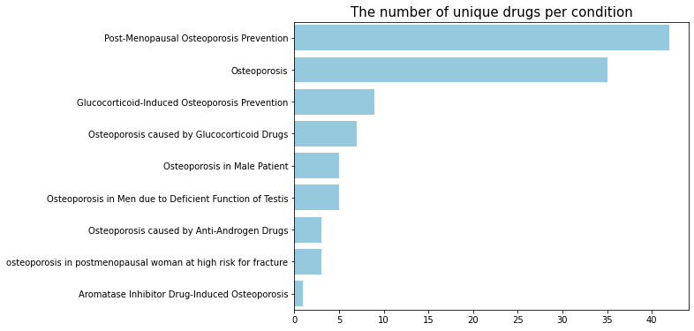
Most Treated Conditions
Observation:
Post-Menopausal Osteoporosis Prevention and Osteoporosis had the most number of unique treatments.
Recall:
The client treats
Post-Menopausal Osteoporosis.
37

Slide 38
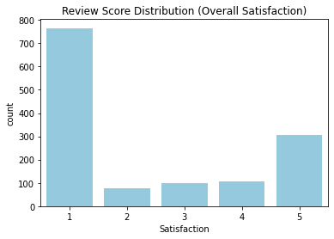
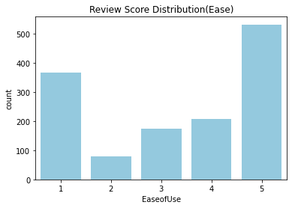
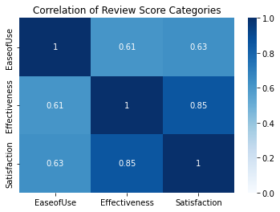
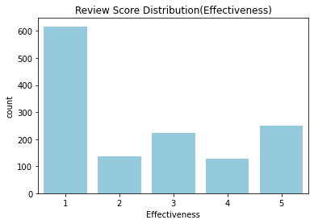
What is generally driving satisfaction? Ease of use or effectiveness?
1. Satisfaction is highly correlated with effectiveness. Moderately with ease of use.
2. Reviews tend to have higher ease of use ratings and lower satisfaction ratings.

Slide 39
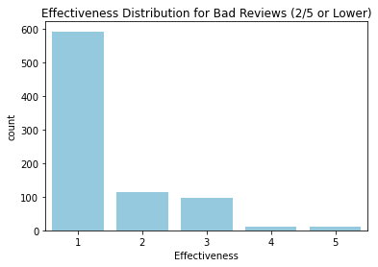
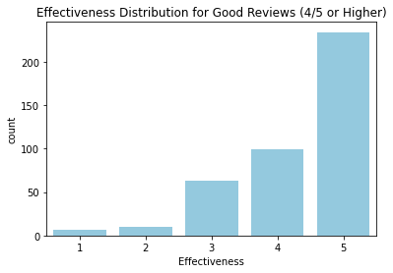
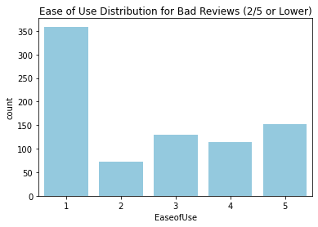
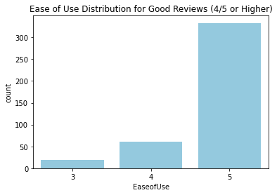
Good Reviews and Bad Reviews: What can we understand from the sub-categories?
1. Low effectiveness = Low satisfaction
2. Low ease of use = Low satisfaction
3. High effectiveness = High satisfaction
4. High ease of use ~ High Satisfaction (Weaker relationship)

Slide 40
Average Ratings for Non-injectable vs. Injectable Treatment: targeted at different age groups
Drug Name | Type | Count
Prolia Syringe Reclast bottle, infusion Zometa vial Atelvia Actonel tablet osteoporosis agents | Injectable Injectable Injectable Non-injectable Non-injectable | 545 148
Notes:
Split up info, direct attention

